Slide 1
Building Our First Neural LM
CSCI 601-471/671 (NLP: Self-Supervised Models)
https://self-supervised.cs.jhu.edu/sp2025/

Slide 2
Logistics
HW2 grades are up!
Min: ?
Max ?
Median: ?
HW4 is released!
Please continue to give us feedback if you see any potential typos, odd phrasings, etc.

Slide 3
Logistics Reminders
Quiz 1: next Tuesday
During the class (~50 mins)
All on paper
Content: everything we discuss before the class (before “Recurrent Neural LMs”)
Note: We also have HW3 deadline which covers the same set of material you will have in your quiz.

Slide 4
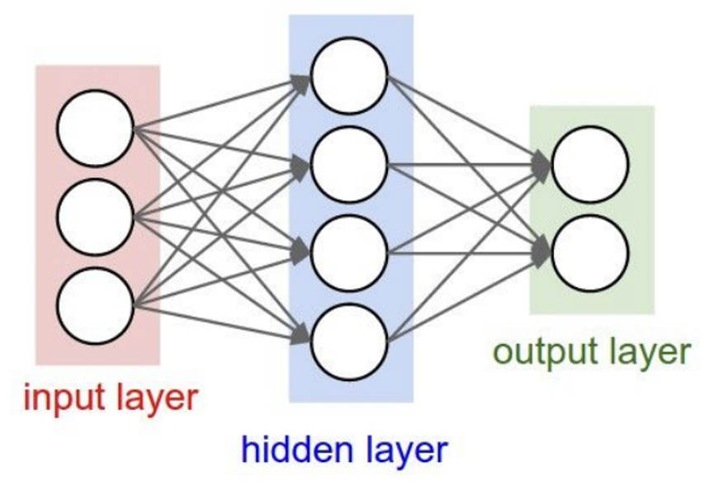
Recap: Neural Nets
A powerful function-approximation tool.
Can be trained efficiently via Backpropagation.
Out focus here: how to use NNs for language modeling.

Slide 5
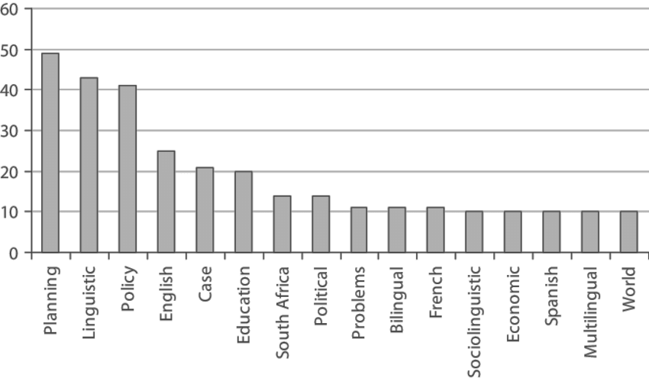
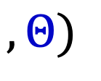
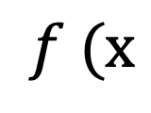
Big Picture: Language Modeling + NNs
How do MLPs are for Language modeling?
Probs over vocabulary
mat
table
into
ant
chair
Remember NNs expect numbers. How do you feed a string to neural net?
$$f (x$$
$$, Θ)$$
and our problems turning
into
context words in window of size 4 target word

Slide 6
Building First Neural LMs
Fixed-window neural language models
Atomic units of language
Chapter goal: Get more comfortable with thinking about the role of neural networks in modeling distribution of language.

Slide 7
Feeding Text to Neural LMs

Slide 8
Feeding Text to Neural Nets
Neural Nets expect numbers.
How do you turn numbers into numbers?

Slide 9




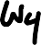
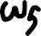
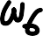
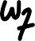

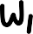
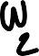
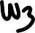
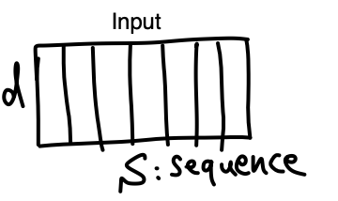
Feeding Text to Neural Nets
Associate each word with a randomly initialized vector.
Pass the vector as input to the model.
One can initialize these vectors with more informative values (e.g. Word2Vec).
Not used in practice.

Slide 10
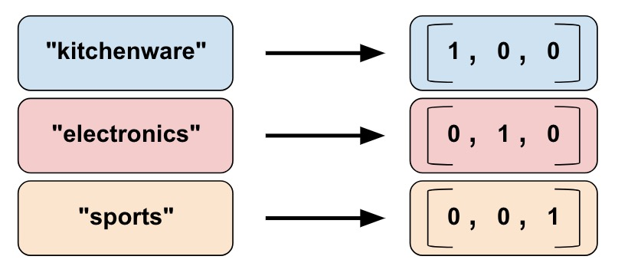
Feeding Text to Neural Net: In Practice
In practice this is implemented in this way:
Turn each word into a unique index
Map each index into a one-hot vector
0
1
2

Slide 11
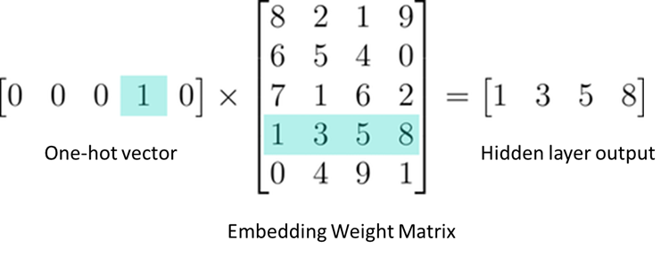
Feeding Text to Neural Net: In Practice
In practice this is implemented in this way:
Turn each word into a unique index
Map each index into a one-hot vector
Lookup the corresponding word embedding via matrix multiplication
Question: what is the size of this embedding matrix?
Note, this embedding matrix is a trainable parameter of the model.

Slide 12
Feeding Text to Neural Net: PyTorch
Initialize a random embedding matrix
# an Embedding module containing 10 tensors of size 3
n, d = 10, 3
embedding = nn.Embedding(n, d) # a batch of 2 samples of 4 indices each
input = torch.LongTensor([[1, 2, 4, 5], [4, 3, 2, 9]])
embedding(input)
tensor([[[-0.0251, -1.6902, 0.7172],
[-0.6431, 0.0748, 0.6969],
[ 1.4970, 1.3448, -0.9685],
[-0.3677, -2.7265, -0.1685]],
[[ 1.4970, 1.3448, -0.9685],
[ 0.4362, -0.4004, 0.9400],
[-0.6431, 0.0748, 0.6969],
Indices corresponding to input units (tokens)
Embeddings corresponding to the inputs

Slide 13
Fixed-Window
MLP Language Models

Slide 14
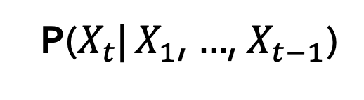
Recap: LMs
next word
context
P($X_{t}$| $X_{1}$, $…$, $X_{t−1}$)
Directly we train models on “conditionals”:
Prob
mat
table
bed
desk
chair
Some model
“The cat sat on the [MASK]”

Slide 15
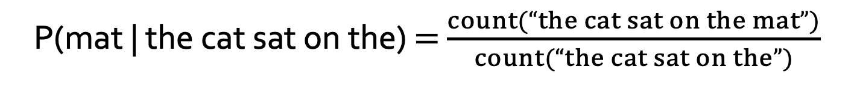
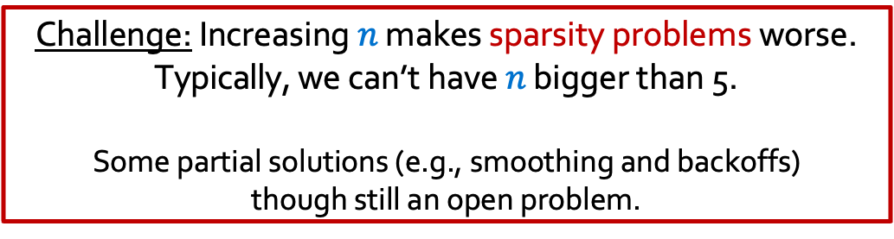
Recap: Counting
next word
context
P($X_{t}$| $X_{1}$, $…$, $X_{t−1}$)
How do we estimate these probabilities?
Let’s just count!
P(mat | the cat sat on the) $=$ $\frac{count(“the cat sat on the mat”)}{count(“the cat sat on the”)}$
Challenge: Increasing $n$ makes sparsity problems worse.
Typically, we can’t have $n$ bigger than 5.
Some partial solutions (e.g., smoothing and backoffs) though still an open problem.
Notes:
This is, in fact, fundamentally what autoregressive models do. Given a sequence, which here we are calling y_1, y_2, ... and so on, an autoregressive model tries to predict y_t from all of the sequence entries before y_t.

Slide 16
Recap Summary
Language Models (LM): distributions over language
N-gram: language modeling via counting
Challenge with large N’s: sparsity problem — many zero counts/probs.
Challenge with small N’s: not very informative and lack of long-range dependencies.

Slide 17
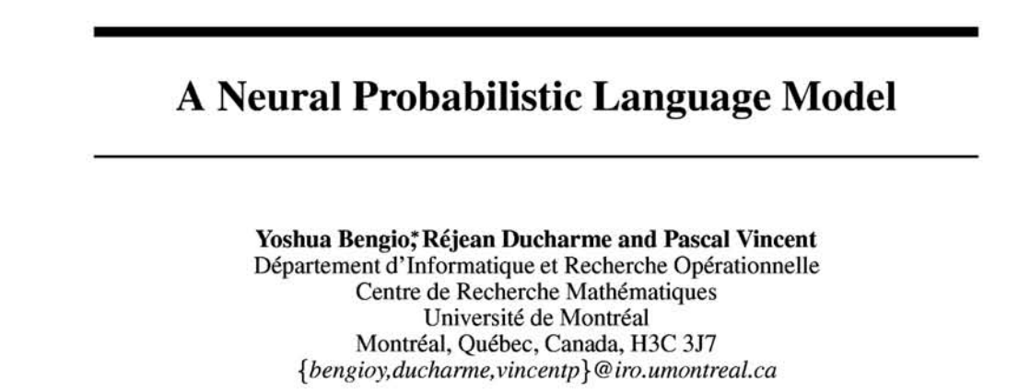
From Counting (N-Gram) to Neural Models
NeurIPS 2000
Probabilistic n-gram models of text generation [Jelinek+ 1980’s, …]
Applications: Speech Recognition, Machine Translation
“Shallow” statistical/neural language models (2000’s) [Bengio+ 1999 & 2001, …]

Slide 18
A Fixed-Window Neural LM
Given the embeddings of the context, predict the word on the right side.
Dropping the right context for simplicity -- not a fundamental limitation.
and
our
problems
turning
into
context words in window of size 4 target word

Slide 19
A Fixed-Window Neural LM
Given the embeddings of the context, predict the word on the right side.
Dropping the right context for simplicity -- not a fundamental limitation.
Discard anything beyond its context window
blah blah blah blah
and
our
problems
turning
into
discard
context words in window of size 4 target word

Slide 20
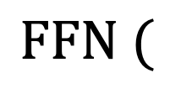
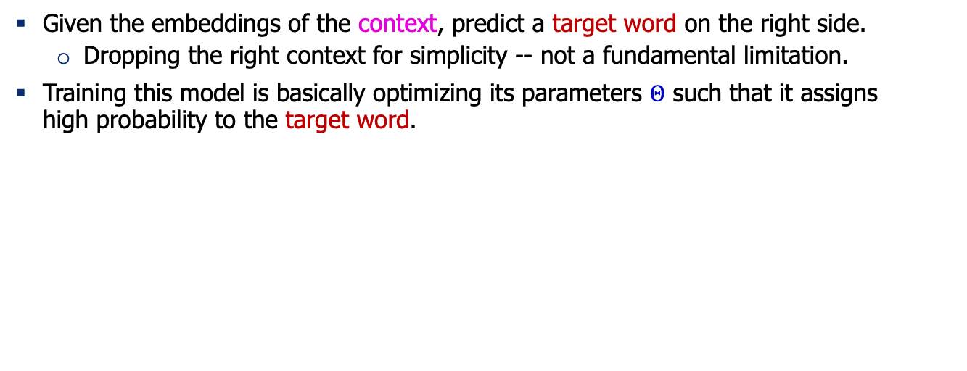
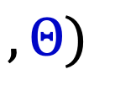
A Fixed-Window Neural LM
Given the embeddings of the context, predict a target word on the right side.
Dropping the right context for simplicity -- not a fundamental limitation.
Training this model is basically optimizing its parameters $Θ$ such that it assigns high probability to the target word.
Probs over vocabulary
Trainable parameters of neural network
mat
table
into
ant
chair
$$FFN ($$
$$, Θ)$$
O O O
O O O
O O O
O O O
lookup embeddings
and
our
problems
turning
into
context words in window of size 4 target word
[Bengio et al. 2003]

Slide 21
A Fixed-Window Neural LM
This is actually a pretty good model!
It will also lay the foundation for the future models (e.g., transformers, ...)
But first we need to figure out how to train neural networks!
Probs over vocabulary
Trainable parameters of neural network
mat
table
into
ant
chair
$$FFN ($$
$$, Θ)$$
O O O
O O O
O O O
O O O
lookup embeddings
and
our
problems
turning
into
context words in window of size 4 target word
[Bengio et al. 2003]

Slide 22
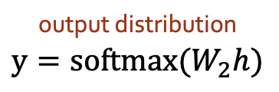
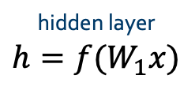
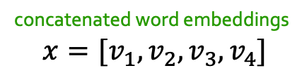
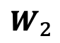
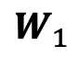
A Fixed-Window Neural LM
Prob
output distribution
$$y=softmax(W_{2}h)$$
mat
table
bed
desk
chair
Softmax
$$W_{2}$$
hidden layer
$$h=f(W_{1}x)$$
O O O O O O O O O O O O O O O
$$W_{1}$$
concatenate
concatenated word embeddings
$$x=[v_{1}, v_{2}, v_{3}, v_{4}]$$
O O O
O O O
O O O
O O O
lookup embeddings
and
our
problems
turning
into
context words in window of size 4 target word
[Bengio et al. 2003]

Slide 23
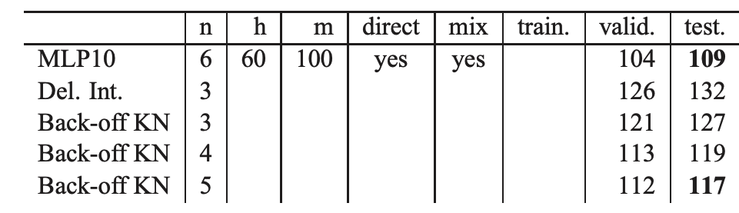
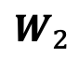
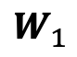
A Fixed-Window Neural LM: Compared to N-Grams
Prob
mat
table
bed
desk
chair
Softmax
Improvements over n-gram LM:
Tackles the sparsity problem
Model size is O(n) not O(exp(n)) — n being the window size.
$$W_{2}$$
O O O O O O O O O O O O O O O
$$W_{1}$$
concatenate
O O O
O O O
O O O
O O O
lookup embeddings
and
our
problems
turning
into
context words in window of size 4 target word
[Bengio et al. 2003, notes from Richard Socher]

Slide 24
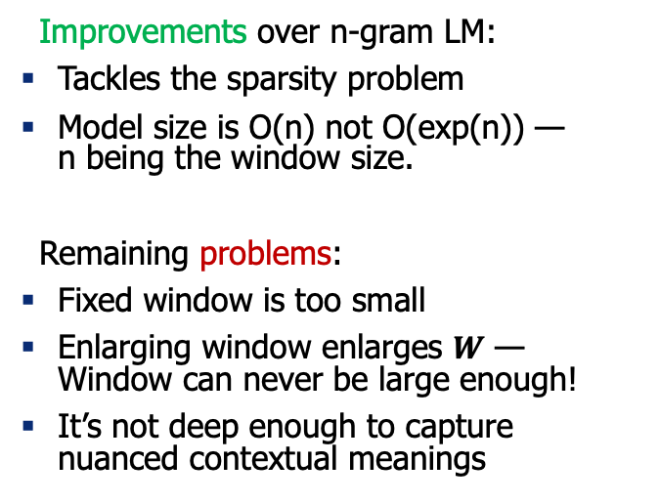
A Fixed-Window Neural LM: Compared to N-Grams
Prob
mat
table
bed
desk
chair
Softmax
Improvements over n-gram LM:
Tackles the sparsity problem
Model size is O(n) not O(exp(n)) — n being the window size.
Remaining problems:
Fixed window is too small
Enlarging window enlarges $W$ — Window can never be large enough!
It’s not deep enough to capture nuanced contextual meanings
$$W_{2}$$
O O O O O O O O O O O O O O O
$$W_{1}$$
concatenate
O O O
O O O
O O O
O O O
lookup embeddings
and
our
problems
turning
into
context words in window of size 4 target word
[Bengio et al. 2003, notes from Richard Socher]

Slide 25
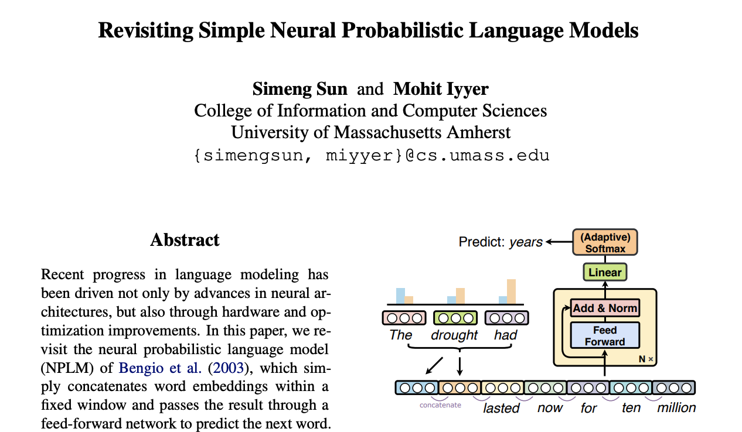
A Fixed-Window Neural LM: Going Deeper

Slide 26
Prob
Softmax
mat
table
bed
desk
chair
Add & Norm
Linear
Feed-Forward layer
xN
Add & Norm
Feed-Forward layer
Add & Norm
concatenate
Feed-Forward layer
N layers
O O O
O O O
O O O
O O O
lookup embeddings
Add & Norm
and
our
problems
turning
into
Feed-Forward layer
context words in window of size 4 target word
[Sun and Iyyer 2021]

Slide 27
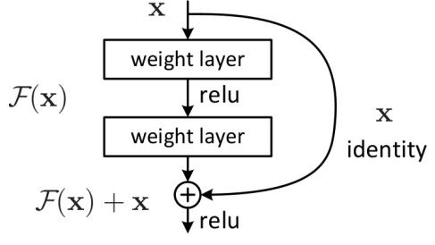
Prob
Softmax
mat
table
bed
desk
chair
Linear
xN
Add & Norm
Feed-Forward layer
Uses residual connections (He et al. 2016) — “information highways” between layers. (we saw them in the earlier chapter)
concatenate
O O O
O O O
O O O
O O O
lookup embeddings
and
our
problems
turning
into
context words in window of size 4 target word
[Sun and Iyyer 2021]

Slide 28
Prob
Softmax
mat
table
bed
desk
chair
Linear
xN
Add & Norm
Feed-Forward layer
Uses layer normalization (Ba et al. 2016) which reduces variance across different data/batches and makes the optimization easier/faster.
concatenate
O O O
O O O
O O O
O O O
lookup embeddings
and
our
problems
turning
into
context words in window of size 4 target word
[Sun and Iyyer 2021]

Slide 29
Prob
Softmax
mat
table
bed
desk
chair
Linear
xN
Use “dropout” to avoid overfitting.
Add & Norm
Feed-Forward layer
concatenate
Use ADAM optimizer (Kingma & Ba, 2017), a variant of Stochastic Gradient Descent.
O O O
O O O
O O O
O O O
lookup embeddings
and
our
problems
turning
into
context words in window of size 4 target word
[Sun and Iyyer 2021]

Slide 30
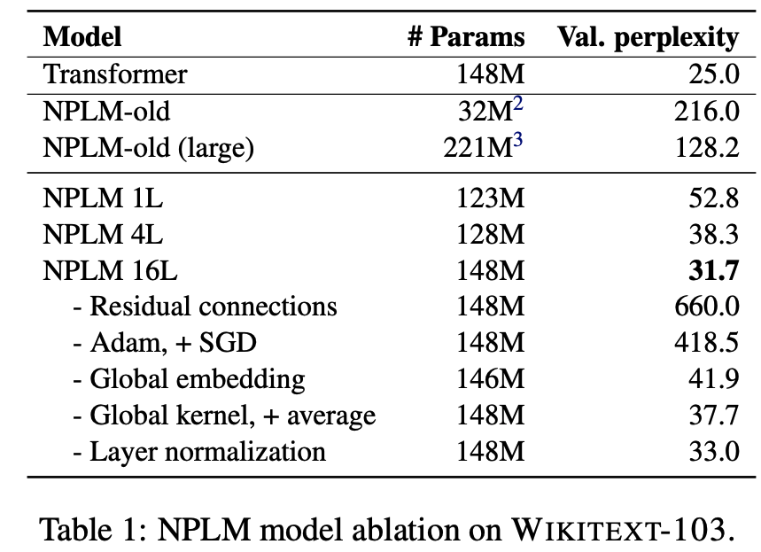
Prob
Softmax
mat
table
bed
desk
chair
Linear
xN
Add & Norm
Feed-Forward layer
concatenate
O O O
O O O
O O O
O O O
Takeaways:
Depth helps
Residual connections are important
Adam works (here) better than SGD
lookup embeddings
and
our
problems
turning
into
context words in window of size 4 target word
[Sun and Iyyer 2021]

Slide 31
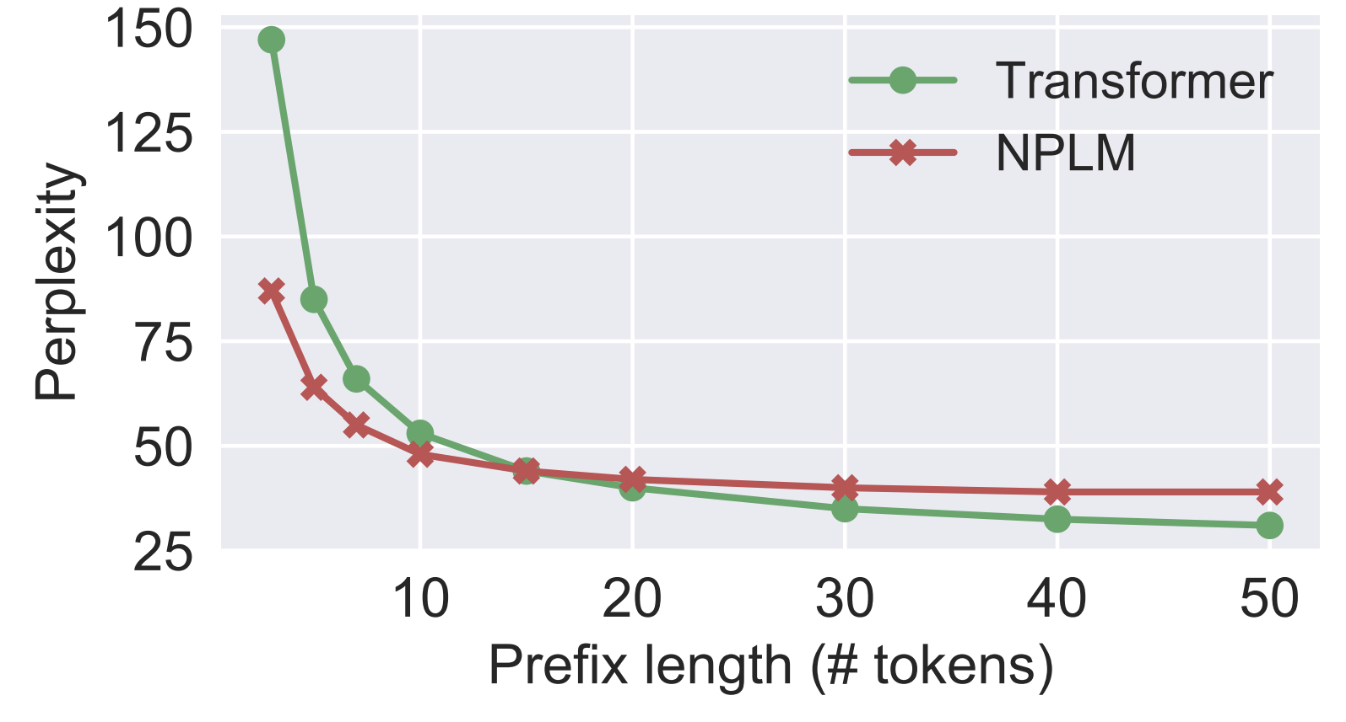
Effect of window size:
Fixed-WindowLM (NPLM) is better than the Transformer (will see them in 2 weeks!) with short prefixes but worse on longer ones.
Prob
Softmax
mat
table
bed
desk
chair
Linear
xN
Add & Norm
Feed-Forward layer
concatenate
O O O
O O O
O O O
O O O
lookup embeddings
and
our
problems
turning
into
context words in window of size 4 target word
[Sun and Iyyer 2021]

Slide 32
Fixed-Window LM in Practice
TBD
Fixed-Window LM trained on Wikipedia:

Slide 33
What Changed from N-Gram LMs to Neural LMs?
What is the source of Neural LM’s strength?
Why sparsity is less of an issue for Neural LMs?
Answer: In n-grams, we treat all prefixes independently of each other! (even those that are semantically similar)
students opened their ___
pupils opened their ___
scholars opened their ___
undergraduates opened their ___
students turned the pages of their ___ students attentively perused their ___
...
Neural LMs are able to share information across these semantically-similar prefixes and overcome the sparsity issue.

Slide 34
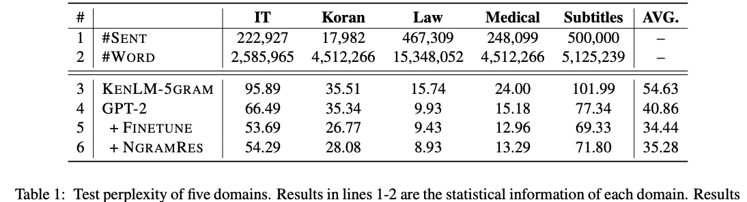
Best of both worlds
n-grams are easy to compute for small ”n”.
Why waste energy to make neural-LMs [re]learn these statistics?
Li et al. 2022 propose learning neural LMs to fits the residual between an n-gram LM and real-data distribution.
Allows the neural part to focus on the deeper understanding of language.
[N-gram Is Back: Residual Learning of Neural Text Generation with n-gram Language Model, Li et al. 2022]

Slide 35
Summary
Language Modeling (LM), a probabilistic model of language
N-gram models (~1980 to early 2000’s)
Difficult to scale to large n’s
Fixed-window Neural LM: first of many LMs we will see in this class
Stronger than n-gram LMs
But still fail at capturing longer contexts
Next: other architectural alternatives.

Slide 36
Atomic Units of Language

Slide 37
The cat sat on the mat.
Notes:
The …

Slide 38
The cat sat on the mat.
words split based on white space?
BOS, The, cat, sat, on, the, mat, ., EOS
characters?
BOS, T, h, e, SPACE, c, a, t, SPACE, s, …
bytes??!
011000010111000001110000011011000110010101100001
1110000011100000110110001100101011000010111000 …
Notes:
The …

Slide 39
The cat sat on the mat.
words split based on white space?
BOS, The, cat, sat, on, the, mat, ., EOS
characters?
BOS, T, h, e, SPACE, c, a, t, SPACE, s, …
bytes??!
011000010111000001110000011011000110010101100001
1110000011100000110110001100101011000010111000 …
Which one should we use as the atomic building blocks for modeling language? 🤔
Notes:
The …

Slide 40
Cost of Using Word Units
What happens when we encounter a word at test time that we’ve never seen in our training data?
Loquacious:
Omnishambles:
COVID-19: was unseen until 2020!
Acknowleadgement: incorrect spelling of “Acknowledgement”
What about relevant words?: “dog” vs “dogs”; ”run” vs “running”
We would need a very large vocabulary to capture common words in a language.
Very large vocabulary size makes training difficult
What happens with words that we haven’t seen before?
With word level tokenization, we have no way of understanding an unseen word!
Also, not all languages have spaces between words like English!
Tending to talk a great deal; talkative.
A situation that has been mismanaged, due to blunders and miscalculations.

Slide 41
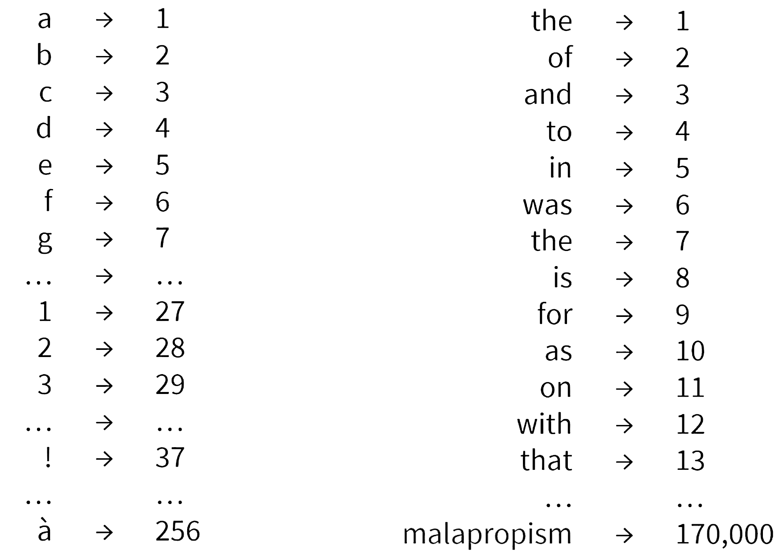
Cost of Using Character Units
What if we use characters?
Pro:
(1) small vocabulary, just the number of unique characters in the training data.
(2) fewer out-of-vocabulary tokens
Cost: much longer input sequences
As we discussed, modeling long-range dependences is very challenging.
Representing long sequences is computationally costly.

Slide 42
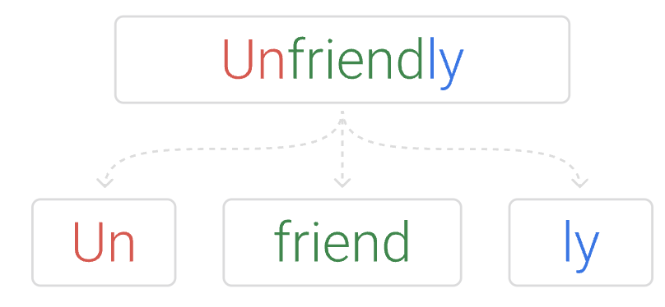
Subword Tokenization: A Middle Ground
Breaks words into smaller units that are indicative of their morphological construction.
Developed for machine translation (Sennrich et al. 2016)
Subword tokenization is the best of both worlds
Common words are preserved in the vocabulary
Less common words are broken down into sub-words
This handles the problem of unseen words and large vocabulary size
Dominantly used in modern language models (BERT, T5, GPT, …)
Relies on a simple algorithm called byte pair encoding (Gage, 1994)
[Improving Neural Machine Translation Models with Monolingual Data, Sennrich et al. 2016]
[A new algorithm for data compression, Gage 1994]

Slide 43
from transformers import AutoTokenizer
tokenizer = AutoTokenizer.from_pretrained("bert-base-cased")
sequence = "Using a Transformer network is simple"
print(tokenizer.tokenize(sequence))
['Using', 'a', ‘Transform', '##er', 'network', 'is', 'simple’]
print(tokenizer.convert_tokens_to_ids(tokens))
[7993, 170, 13809, 23763, 2443, 1110, 3014]
tokenizer = AutoTokenizer.from_pretrained("albert-base-v1")
sequence = "Using a Transformer network is simple"
print(tokenizer.tokenize(sequence))
[‘_using', ‘_a', ‘_transform', 'er', ‘_network', ‘_is', ‘_simple’]

Slide 44
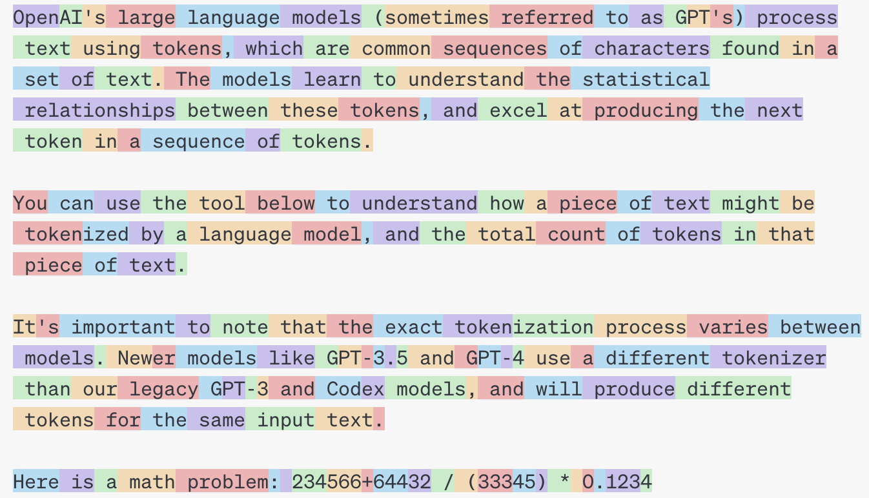
GPT3/4’s Tokenizer
https://platform.openai.com/tokenizer

Slide 45
The Tokenization Pipeline
Normalization
Tokenization
Pos-processing
Pre-tokenization
Strip extra spaces
Unicode normalization, …

Slide 46
The Tokenization Pipeline
Normalization
Tokenization
Pos-processing
Pre-tokenization
White spaces between words and sentences
Punctuations
…

Slide 47
The Tokenization Pipeline
Normalization
Tokenization
Pos-processing
Pre-tokenization
BPE, …. (will discuss this in a second)

Slide 48
The Tokenization Pipeline
Normalization
Tokenization
Pos-processing
Pre-tokenization
Add special tokens: for example [CLS], [SEP] for BERT
Truncate to match the maximum length of the model
Pad all sentences in a batch to the same length

Slide 49
Byte-pair Encoding (BPE)
An algorithm for forming subword tokens based on a collection of raw text.
and there are no re ##fueling stations anywhere
One of the city’s more un ##princi ##pled real state agents
[Improving Neural Machine Translation Models with Monolingual Data, Sennrich et al. 2016]
[A new algorithm for data compression, Gage 1994]

Slide 50
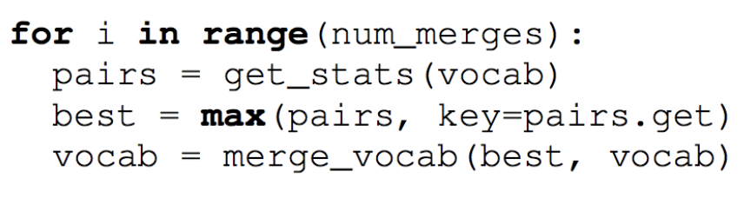
Byte-pair Encoding (BPE)
Idea: Repeatedly merge the most frequent adjacent tokens
Doing 30k merges => vocabulary of around 30k subwords. Includes many whole words.
[Improving Neural Machine Translation Models with Monolingual Data, Sennrich et al. 2016]
[A new algorithm for data compression, Gage 1994]

Slide 51
Byte-pair Encoding (BPE): Example
Form base vocabulary of all characters that occur in the training set.
Example:
Our (very fascinating🙄) training data: “jhu jhu jhu hopkins hop hops hops”
Base vocab: h, i, j, k, n, o, p, s, u
Tokenized data: j h u j h u j h u h o p k i n s h o p h o p s h o p s
Does not show the word separator for simplicity.
[Improving Neural Machine Translation Models with Monolingual Data, Sennrich et al. 2016]
[A new algorithm for data compression, Gage 1994]

Slide 52
Byte-pair Encoding: Example (2)
Count the frequency of each token pair in the data
Example:
Our (very fascinating🙄) training data: “jhu jhu jhu hopkins hop hops hops”
Base vocab: h, i, j, k, n, o, p, s, u
Tokenized data: j h u j h u j h u h o p k i n s h o p h o p s h o p s
Token pair frequencies:
j + h -> 3
h + u -> 3
h + o -> 4
o + p -> 4
p + k -> 1
k + i -> 1
….
[Improving Neural Machine Translation Models with Monolingual Data, Sennrich et al. 2016]
[A new algorithm for data compression, Gage 1994]

Slide 53
Byte-pair Encoding: Example (3)
Choose the pair that occurs more, merge them and add to vocab.
Example:
Our (very fascinating🙄) training data: “jhu jhu jhu hopkins hop hops hops”
Base vocab: h, i, j, k, n, o, p, s, u
Tokenized data: j h u j h u j h u h o p k i n s h o p h o p s h o p s
Token pair frequencies:
j + h -> 3
h + u -> 3
h + o -> 4
o + p -> 4
p + k -> 1
k + i -> 1
….
[Improving Neural Machine Translation Models with Monolingual Data, Sennrich et al. 2016]
[A new algorithm for data compression, Gage 1994]

Slide 54
Byte-pair Encoding: Example (4)
Choose the pair that occurs more, merge them and add to vocab.
Example:
Our (very fascinating🙄) training data: “jhu jhu jhu hopkins hop hops hops”
Base vocab: h, i, j, k, n, o, p, s, u, ho
Tokenized data: j h u j h u j h u h o p k i n s h o p h o p s h o p s
Token pair frequencies:
j + h -> 3
h + u -> 3
h + o -> 4
o + p -> 4
p + k -> 1
k + i -> 1
….
[Improving Neural Machine Translation Models with Monolingual Data, Sennrich et al. 2016]
[A new algorithm for data compression, Gage 1994]

Slide 55
Byte-pair Encoding: Example (5)
Retokenize the data
Example:
Our (very fascinating🙄) training data: “jhu jhu jhu hopkins hop hops hops”
Base vocab: h, i, j, k, n, o, p, s, u, ho
Tokenized data: j h u j h u j h u ho p k i n s ho p ho p s ho p s
Token pair frequencies:
[Improving Neural Machine Translation Models with Monolingual Data, Sennrich et al. 2016]
[A new algorithm for data compression, Gage 1994]

Slide 56
Byte-pair Encoding: Example (6)
Count the token pairs and merge the most frequent one
Example:
Our (very fascinating🙄) training data: “jhu jhu jhu hopkins hop hops hops”
Base vocab: h, i, j, k, n, o, p, s, u, ho
Tokenized data: j h u j h u j h u ho p k i n s ho p ho p s ho p s
Token pair frequencies:
j + h -> 3
h + u -> 3
ho + p -> 4
p + k -> 1
k + i -> 1
i + n -> 1
….
[Improving Neural Machine Translation Models with Monolingual Data, Sennrich et al. 2016]
[A new algorithm for data compression, Gage 1994]

Slide 57
Byte-pair Encoding: Example (7)
Count the token pairs and merge the most frequent one
Example:
Our (very fascinating🙄) training data: “jhu jhu jhu hopkins hop hops hops”
Base vocab: h, i, j, k, n, o, p, s, u, ho
Tokenized data: j h u j h u j h u ho p k i n s ho p ho p s ho p s
Token pair frequencies:
j + h -> 3
h + u -> 3
ho + p -> 4
p + k -> 1
k + i -> 1
i + n -> 1
….
[Improving Neural Machine Translation Models with Monolingual Data, Sennrich et al. 2016]
[A new algorithm for data compression, Gage 1994]

Slide 58
Byte-pair Encoding: Example (7)
Count the token pairs and merge the most frequent one
Example:
Our (very fascinating🙄) training data: “jhu jhu jhu hopkins hop hops hops”
Base vocab: h, i, j, k, n, o, p, s, u, ho, hop
Tokenized data: j h u j h u j h u ho p k i n s ho p ho p s ho p s
Token pair frequencies:
j + h -> 3
h + u -> 3
ho + p -> 4
p + k -> 1
k + i -> 1
i + n -> 1
….
[Improving Neural Machine Translation Models with Monolingual Data, Sennrich et al. 2016]
[A new algorithm for data compression, Gage 1994]

Slide 59
Byte-pair Encoding: Example (7)
Count the token pairs and merge the most frequent one
Example:
Our (very fascinating🙄) training data: “jhu jhu jhu hopkins hop hops hops”
Base vocab: h, i, j, k, n, o, p, s, u, ho, hop
Tokenized data: j h u j h u j h u hop k i n s hop hop s hop s
Token pair frequencies:
j + h -> 3
h + u -> 3
ho + p -> 4
p + k -> 1
k + i -> 1
i + n -> 1
….
[Improving Neural Machine Translation Models with Monolingual Data, Sennrich et al. 2016]
[A new algorithm for data compression, Gage 1994]

Slide 60
Byte-pair Encoding: Example (8)
Count the token pairs and merge the most frequent one
Example:
Our (very fascinating🙄) training data: “jhu jhu jhu hopkins hop hops hops”
Base vocab: h, i, j, k, n, o, p, s, u, ho, hop
Tokenized data: j h u j h u j h u hop k i n s hop hop s hop s
Token pair frequencies:
j + h -> 3
h + u -> 3
hop + k -> 1
hop + s -> 2
k + i -> 1
i + n -> 1
n + s -> 1
….
[Improving Neural Machine Translation Models with Monolingual Data, Sennrich et al. 2016]
[A new algorithm for data compression, Gage 1994]

Slide 61
Byte-pair Encoding: Example (8)
Count the token pairs and merge the most frequent one
Example:
Our (very fascinating🙄) training data: “jhu jhu jhu hopkins hop hops hops”
Base vocab: h, i, j, k, n, o, p, s, u, ho, hop, jh
Tokenized data: j h u j h u j h u hop k i n s hop hop s hop s
Token pair frequencies:
j + h -> 3
h + u -> 3
hop + k -> 1
hop + s -> 2
k + i -> 1
i + n -> 1
n + s -> 1
….
[Improving Neural Machine Translation Models with Monolingual Data, Sennrich et al. 2016]
[A new algorithm for data compression, Gage 1994]

Slide 62
Byte-pair Encoding: Example (8)
Count the token pairs and merge the most frequent one
Example:
Our (very fascinating🙄) training data: “jhu jhu jhu hopkins hop hops hops”
Base vocab: h, i, j, k, n, o, p, s, u, ho, hop, jh
Tokenized data: jh u jh u jh u hop k i n s hop hop s hop s
Token pair frequencies:
j + h -> 3
h + u -> 3
hop + k -> 1
hop + s -> 2
k + i -> 1
i + n -> 1
n + s -> 1
….
[Improving Neural Machine Translation Models with Monolingual Data, Sennrich et al. 2016]
[A new algorithm for data compression, Gage 1994]

Slide 63
Byte-pair Encoding: Example (8)
Count the token pairs and merge the most frequent one
Example:
Our (very fascinating🙄) training data: “jhu jhu jhu hopkins hop hops hops”
Base vocab: h, i, j, k, n, o, p, s, u, ho, hop, jh
Tokenized data: jh u jh u jh u hop k i n s hop hop s hop s
Token pair frequencies:
j h+u -> 3
hop + k -> 1
hop + s -> 2
k + i -> 1
i + n -> 1
n + s -> 1
….
[Improving Neural Machine Translation Models with Monolingual Data, Sennrich et al. 2016]
[A new algorithm for data compression, Gage 1994]

Slide 64
Byte-pair Encoding: Example (8)
Count the token pairs and merge the most frequent one
Example:
Our (very fascinating🙄) training data: “jhu jhu jhu hopkins hop hops hops”
Base vocab: h, i, j, k, n, o, p, s, u, ho, hop, jh, jhu
Tokenized data: jh u jh u jh u hop k i n s hop hop s hop s
Token pair frequencies:
j h+u -> 3
hop + k -> 1
hop + s -> 2
k + i -> 1
i + n -> 1
n + s -> 1
….
[Improving Neural Machine Translation Models with Monolingual Data, Sennrich et al. 2016]
[A new algorithm for data compression, Gage 1994]

Slide 65
Byte-pair Encoding: Example (8)
Count the token pairs and merge the most frequent one
Example:
Our (very fascinating🙄) training data: “jhu jhu jhu hopkins hop hops hops”
Base vocab: h, i, j, k, n, o, p, s, u, ho, hop, jh, jhu
Tokenized data: jhu jhu jhu hop k i n s hop hop s hop s
Token pair frequencies:
j h+u -> 3
hop + k -> 1
hop + s -> 2
k + i -> 1
i + n -> 1
n + s -> 1
….
[Improving Neural Machine Translation Models with Monolingual Data, Sennrich et al. 2016]
[A new algorithm for data compression, Gage 1994]

Slide 66
Byte-pair Encoding
This can be a lot if including all unicode characters (there are ~138K unicode symbols)!
GPT-2 uses bytes as the base vocabulary (size 256) and then applies BPE on top of this sequence (with some rules to prevent certain types of merges).
Commonly have vocabulary sizes of 32K to 64K

Slide 67
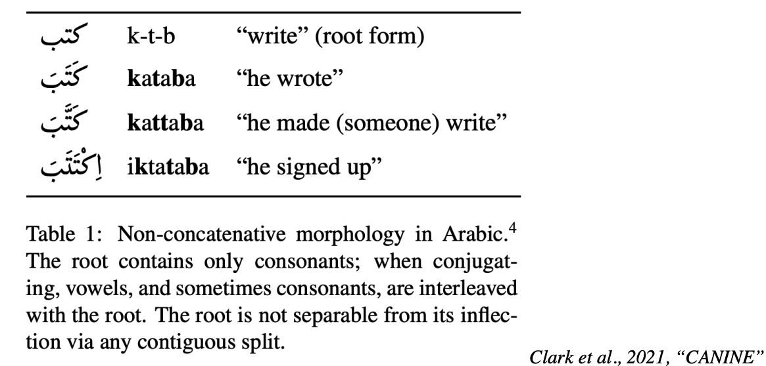
Limitations of Subwords
Hard to apply to languages with non-concatenative (e.g., Arabic) morphology

Slide 68
Other Subword Encodings
WordPiece (Schuster & Nakajima, ICASSP 2012): merge by likelihood as measured by language model, not by frequency
While voc size < target:
Build a language model over your corpus
Merge tokens that lead to highest improvement in LM perplexity
Issues: What LM to use? How to make it tractable?
[ Shuster & Nakajima 2012; Wu et al. 2016]

Slide 69
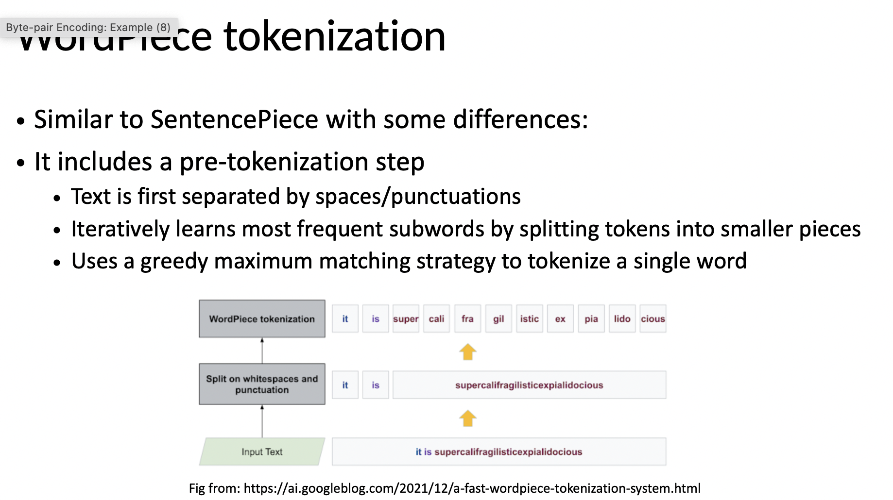

Slide 70
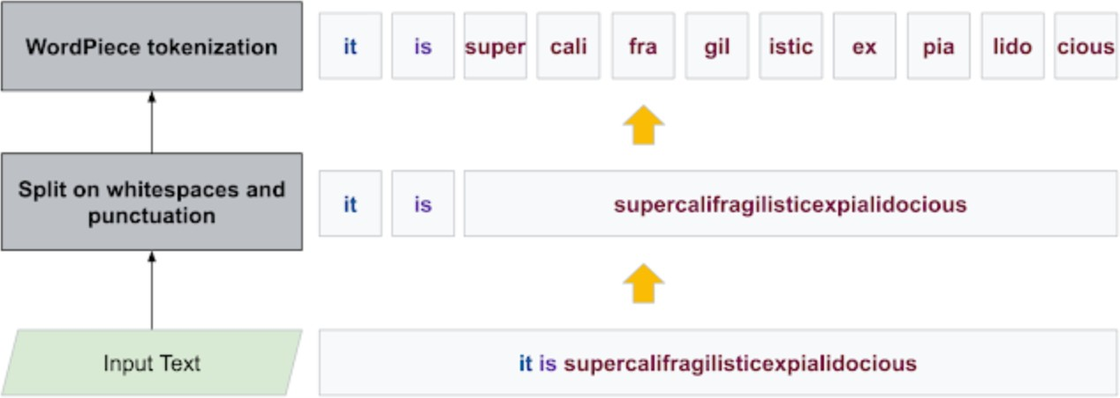
WordPiece tokenization
Similar to SentencePiece with some differences:
It includes a pre-tokenization step
Text is first separated by spaces/punctuations
Iteratively learns most frequent subwords by splitting tokens into smaller pieces
Uses a greedy maximum matching strategy to tokenize a single word
Fig from: https://ai.googleblog.com/2021/12/a-fast-wordpiece-tokenization-system.html

Slide 71
WordPiece tokenization
Encoding: Greedy longest prefix match. Example:
Vocabulary: {“a”, “jui”, “ce”, “blue”, “is”, “ber”, “ry”}
a blueberry juice -> “a” in vocab -> [“a”]
a blueberry juice -> “blueberry” not in vocab
-> prefix max match: “blue” -> [“a”, “blue”]
-> remaining subword: “berry” “berry” not in vocab
-> prefix max match: “ber” -> [“a”, “blue”, “ber”]
“ry” in vocab -> [“a”, “blue”, “ber”, “ry”] a blueberry juice -> “juice” not in vocab
-> prefix max match: “jui” in vocab -> [“a”, “blue”, “ber”, “ry”, “jui”]
“ce” in vocab -> [“a”, “blue”, “ber”, “ry”, “jui”, “ce”]

Slide 72
WordPiece tokenization
Byte-level Byte Pair Encoding (BBPE)
Neural Machine Translation with Byte-Level Subwords (2019) — Used in GPT-2
UTF8 encoding of text
Encodes each character into 1 to 4 bytes
The sentence is a sequence of bytes instead of characters
Represent a sentence in any language as a sequence of UTF8 bytes
A byte sequence representation of text is often much longer (up to 4x) than a character sequence representation
segmenting a byte sequence into variable-length n-grams (byte-level “subwords”)
learn BPE vocabulary on the byte-level representation which extends UTF-8 byte set with byte n-grams

Slide 73
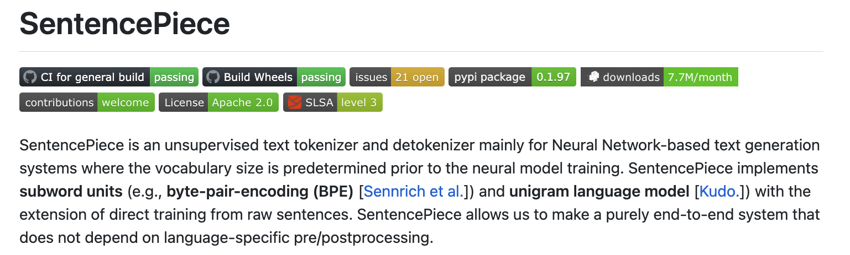
Other Subword Encodings (2)
SentencePiece (Kudo et al., 2018):
A more advanced tokenized extending BPE
Good for languages that don’t always separate words w/ spaces.
https://github.com/google/sentencepiece
[SentencePiece, Kudo & Richardson 2018]

Slide 74
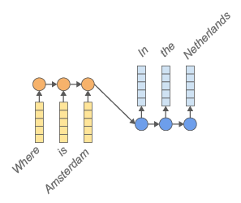
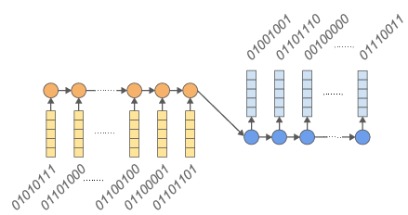
Other Subword Encodings (3)
Use byte representation of words
E.g., H -> 01010111
Vocabulary size: 2^8=256
Limitation:
Makes the sequence length 4 to 5x longer
At test time it is also slower to generate sentences. Why?
Need to generate one character at a time
[Byte-level machine reading across morphologically varied languages, Kenter et al. 2018; ByT5: Towards a Token-Free Future with Pre-trained Byte-to-Byte Models, Xue at al. 2021, and several others]

Slide 75
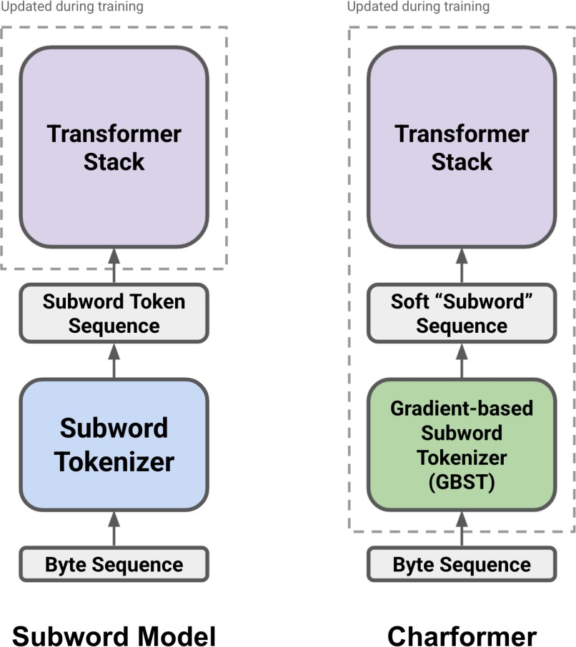
CharFormer (Tay et al., 2022)
Many approaches have separate fixed tokenization pipeline
CharacterLevel and ByteLevel methods are slow and inefficient
What if we include the tokenization into the training?
CharFormer: gradient-based subword tokenization (GBST)
combines the compositionally of character-level representationscwith efficiency of subword tokenization
it is end-to-end trainable

Slide 76
CharFormer (Tay et al., 2022)
Intuition: break input sequence up into various sized blocks.
E.g., Every block of size 1, 2, 3, 4.
Each block is represented by a single block embedding.
Use a parameterized block scoring network to score every block.
I.e., Which block to select for every character position?
Construct a representation at every position using a weighted sum of block embeddings across the block sizes.

Slide 77
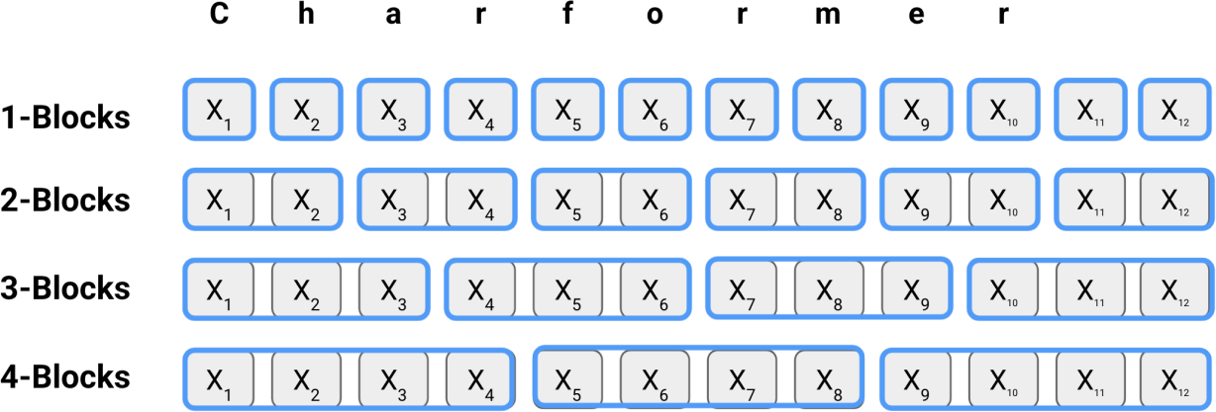

Slide 78
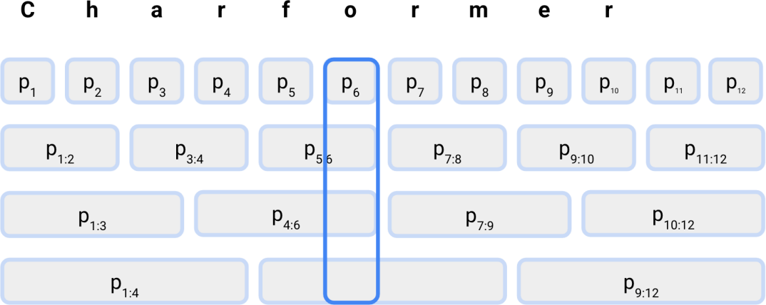

Slide 79
Limitation of subword
Language Dependency: Even though subwords helps in multiple- languages it may favor the structure of one language vs the other
Loss of whole word semantics
E.g., “Understand” -> [“Under”, “stand”]
Doesn’t mean “stand beneath”!

Slide 80
Summary
Fundamental question: what should be the atomic unit of representation?
Words: too coarse
Characters: too small
Subwords:
A useful representational choice for language.
Capture language morphology

Slide 81
Recap: input pipeline
I love Peperroni Pizza
tokenization

Slide 82
Recap: input pipeline
I love Peperroni Pizza
tokenization
["I ", " _love ", "▁Pep", "per", "oni", "▁pizza"]

Slide 83
Recap: input pipeline
I love Peperroni Pizza
tokenization
["I ", " _love ", "▁Pep", "per", "oni", "▁pizza"]
Embedding matrix
𝑑
Vocab size

Slide 84
Recap: input pipeline
I love Peperroni Pizza
tokenization
["I ", " _love ", "▁Pep", "per", "oni", "▁pizza"]
Input
Embedding matrix
𝑑
𝑑
I
n
p
ut
Vocab size
Sequence length

Slide 85
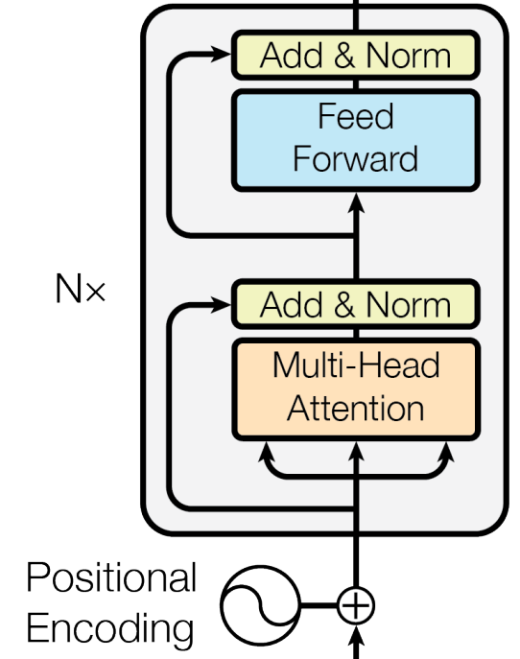
Recap: input pipeline
I love Peperroni Pizza
tokenization
["I ", " _love ", "▁Pep", "per", "oni", "▁pizza"]
Input
Embedding matrix
𝑑
𝑑
I
n
p
ut
Vocab size
Sequence length

